Slide 1
PRESENTED BY :
SUMANTH REDDY
SWETHA
NAVEEN VARMA

Slide 2



NETFLIX MOVIES & TV SHOWS

Slide 3

INTRODUCTION
Dataset: Netflix TV Shows and Movies
Hypothesis:
Finding the first 5 data using Head & Tail?
2. Are certain genres more prevalent on Netflix?
3. Are there certain countries that produce more content on Netflix?
Movies have a more expressive amount of attractions in Netflix.
Are there certain actors who are more frequently cast on Netflix?
6. Are there certain genres that tend to have higher ratings on Netflix?
.

Slide 4
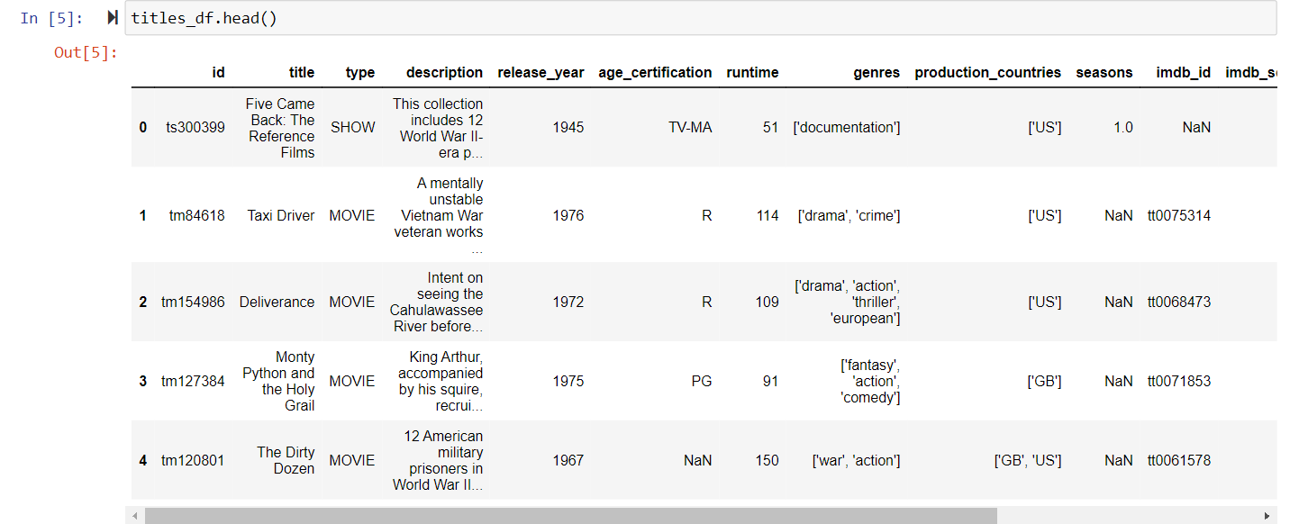
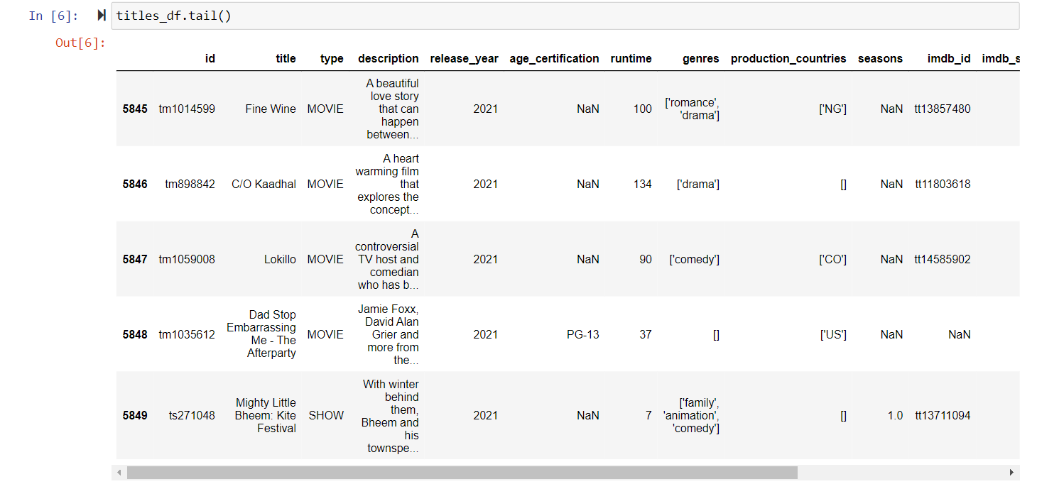
Project analysis slide 4
1. Finding the first 5 data using Head & Tail?

Slide 5
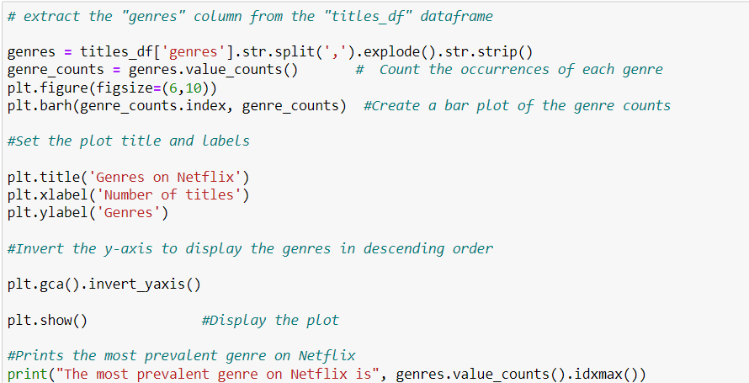
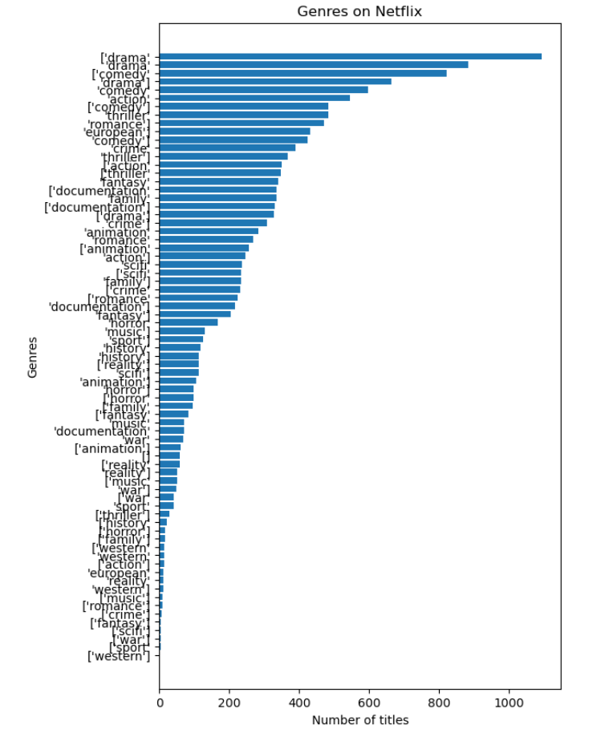
Project analysis slide 5
2. Are certain genres more prevalent on Netflix?
The output for the given hypothesis states that most prevalent genre on Netflix is ['drama]

Slide 6
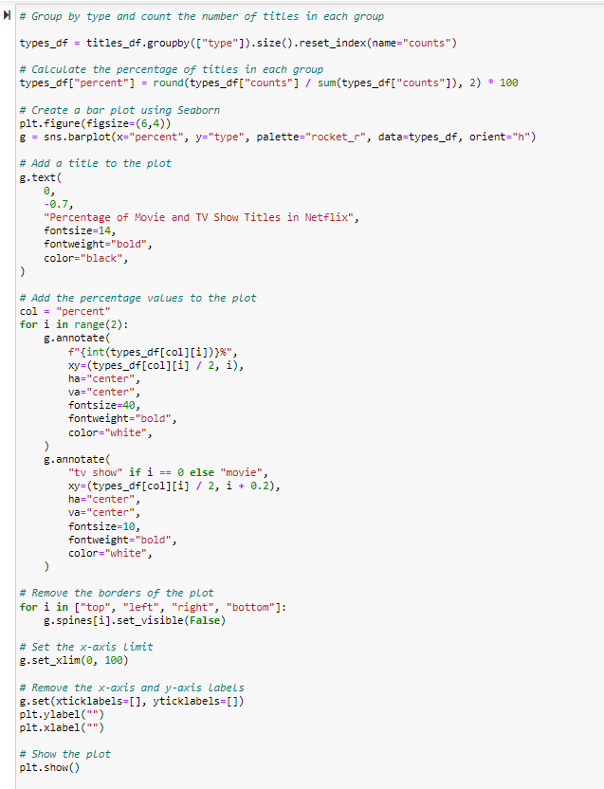
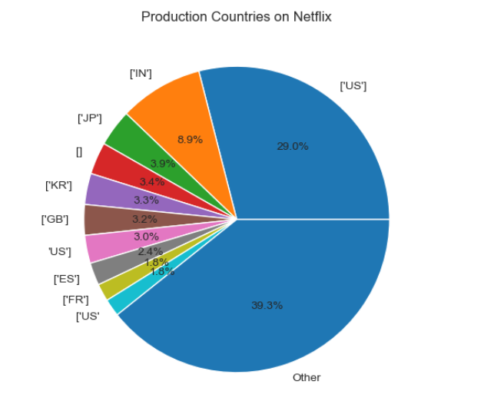
Project analysis slide 7
3.Are there certain countries that produce more content on Netflix?
The Output for the given hypothesis states that country produces the most content on Netflix is ['US']

Slide 7
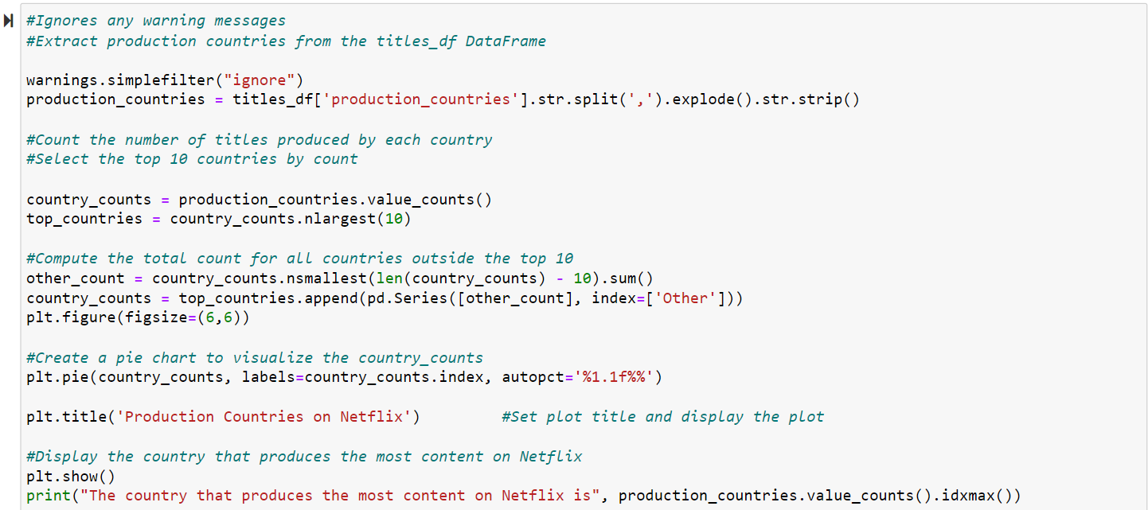
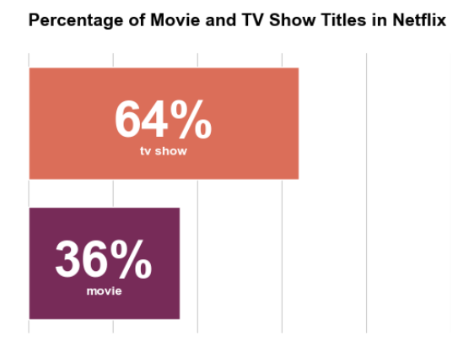
Project analysis slide 6
4. Movies have a more expressive amount of attractions in Netflix.
The Output for the above hypothesis states that “Tv series tend to have longer runtimes than movies on Netflix.”

Slide 8
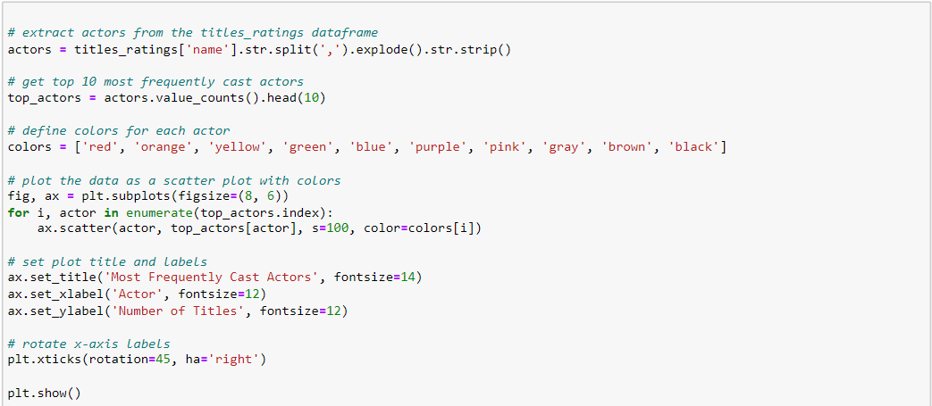
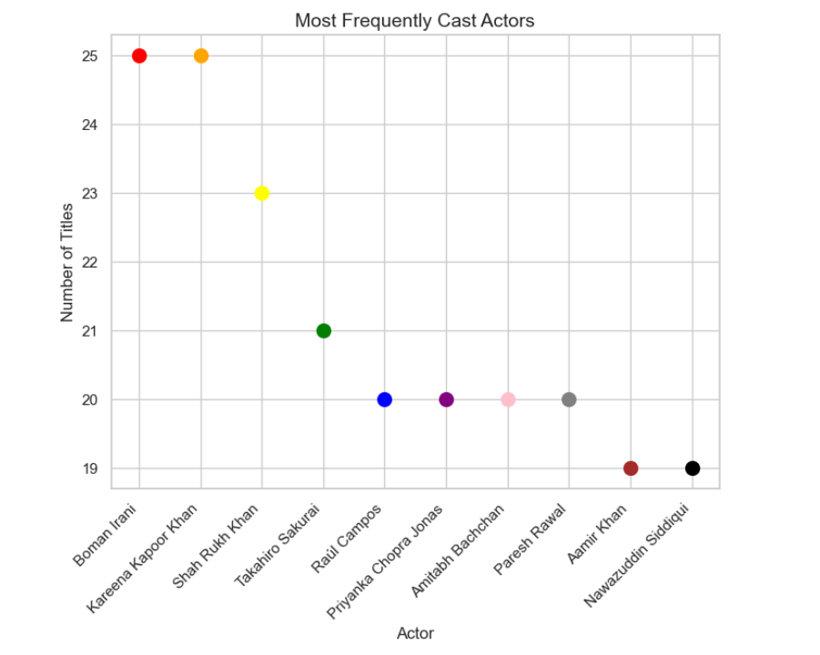
Project analysis slide 8
5.Are there certain actors who are more frequently cast on Netflix?
The output for the above hypothesis states that the most frequently cast actor on Netflix is Boman Irani

Slide 9
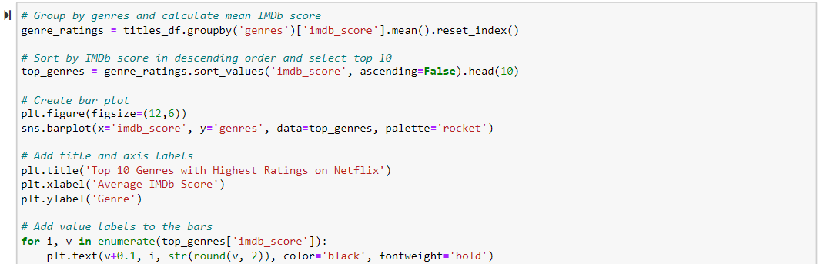
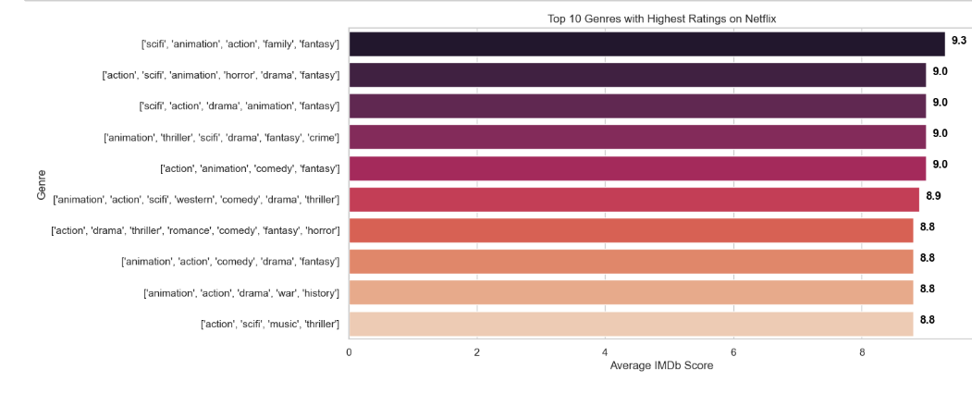
Project analysis slide 3
6. Are there certain genres that tend to have higher ratings on Netflix?
The output for the above hypothesis generates the genres that have higher ratings on Netflix . Which is “ [ scifi , animation , acrion , family , fantasy ] ”.

Slide 10

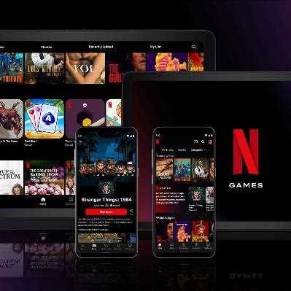
CONCLUSION
Netflix movies and TV shows provides a comprehensive collection of data on the popular streaming service, including details on the titles, release dates, ratings, and other information related to the content available on the platform.
Analyzing this dataset can provide insights into trends in the entertainment industry, such as the popularity of different genres, the types of content that are most frequently added to the platform, and the factors that influence user ratings.
Overall, this dataset is a valuable resource for researchers, data analysts, and anyone interested in understanding the streaming media landscape and the factors that drive success in this industry.

Slide 11
References
Netflix Movies and TV Shows Dataset from Kaggle.com:
https://www.kaggle.com/datasets/victorsoeiro/netflix-tv-shows-and-movies

Slide 12

THANK YOU
Does anyone have any questions?

